Slide 1

Helping You Reach Out to Your Book Loving Customers Better
PROJECT - 01

Slide 2

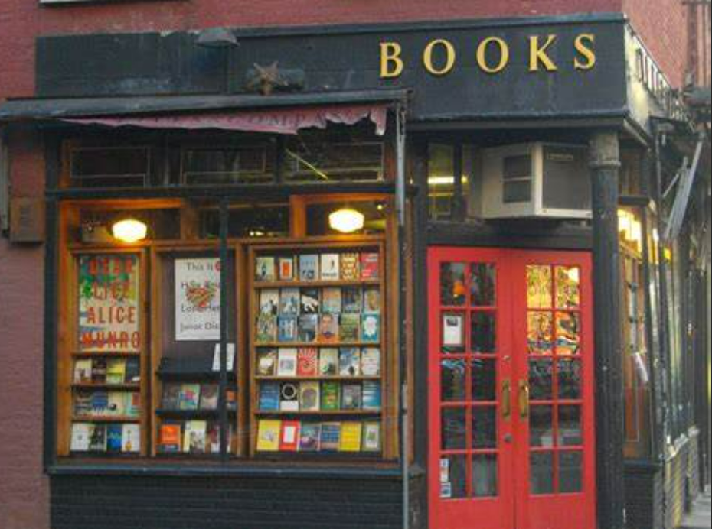
Group Members
Norma Espinosa
Swapnali Mehta
Laleh Safarzadeh
Kristen Wilder
Angele Yazbec

Slide 3

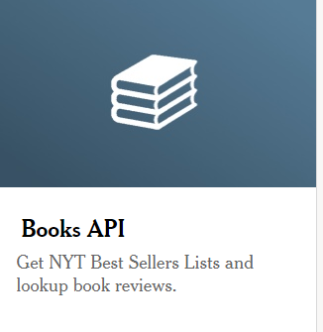
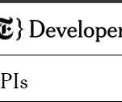
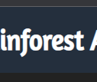
Data to be used:
New York Times Books API
- Obtain bestsellers for hardcover fiction - Obtain bestsellers for hardcover nonfiction - Wide enough time frame to obtain at least 1000 books (maybe 2-3 years)
Rainforest API—Amazon Product API

Slide 4
Research Questions
Preference for printed, e-books, audiobook (sales numbers for both) on Amazon?
Summary statistics and bar chart/pie chart
What are the price differences for Kindle versus printed copy on Amazon? Summary statistics and bar chart
Scatter plot with regression line
Which category of book is most popular (adult nonfiction or adult fiction)? Summary statistics and bar chart/pie chart
What is the rating for the top five books and their authors?
What is the price average per category?
Category with more ratings/sales?
What is the rating average per category?

Slide 5

Task Outline
Task 1: Mine data from New York Times Book API, clean data, create csv
Task 2: Mine data from Rainforest API, clean data, add to csv
Task 3: Exploratory data analysis
Task 4: Visualizations
Presentation/PowerPoint
Write-Up Summarizing Finding

Slide 6
Task Division
Laleh—New York Times API data mining, cleaning using Pandas, create CSV file, help with summary and PPT
Angele—Rainforest API data mining, cleaning using Pandas, merge with prior CSV file and clean, write-up summarizing major findings, assist with PPT
Norma—For some of the research questions: conduct exploratory data analyses with Pandas, data visualizations (Pandas and/or matplotlib), assemble PowerPoint and add visuals
Kristen— For some of the research questions: conduct exploratory data analyses with Pandas, data visualizations (Pandas and/or matplotlib), assist with PowerPoint and add visuals, assist with summary
Swapnali— For some research questions: conduct exploratory data analyses with Pandas, data visualizations (Pandas and/or matplotlib), assist with reviewing PPT and summary

Slide 7



Slide 8

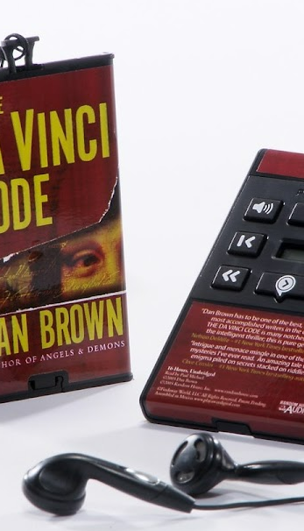

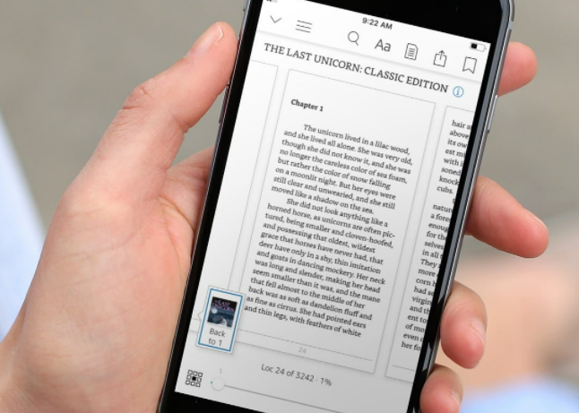

Slide 9



Slide 10


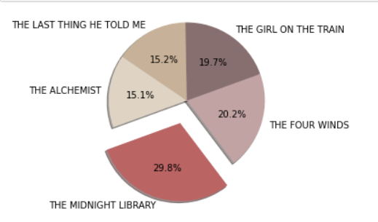



What are the rating for the top five authors and their books?

Slide 11
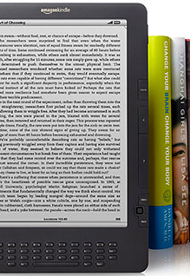

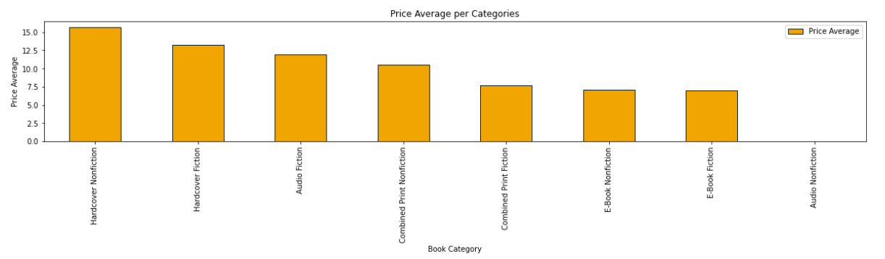
What is the price average per category? The Hardcover Nonfiction has highest price…

Slide 12
Research Question 6:
V Category with more ratings/sales
The E-Book Fiction is the category with more ratings/sales and the second category the Combined Print Fiction.
Research Question 7:
vWhat is the price average per categories?
We found out that the most expensive book category is Hardcover Nonfiction.
Amazon has sales on Audio Fiction, and it is the 3rd more expensive category, however the Audio Nonfiction category does not have data or Amazon gives for free Audio Nonfiction or are free for subscribers.
Research Question 8:
vWhat is the rating average per category?
We found out that Audio Fiction has more ratings than the rest of the categories

